Slide 1
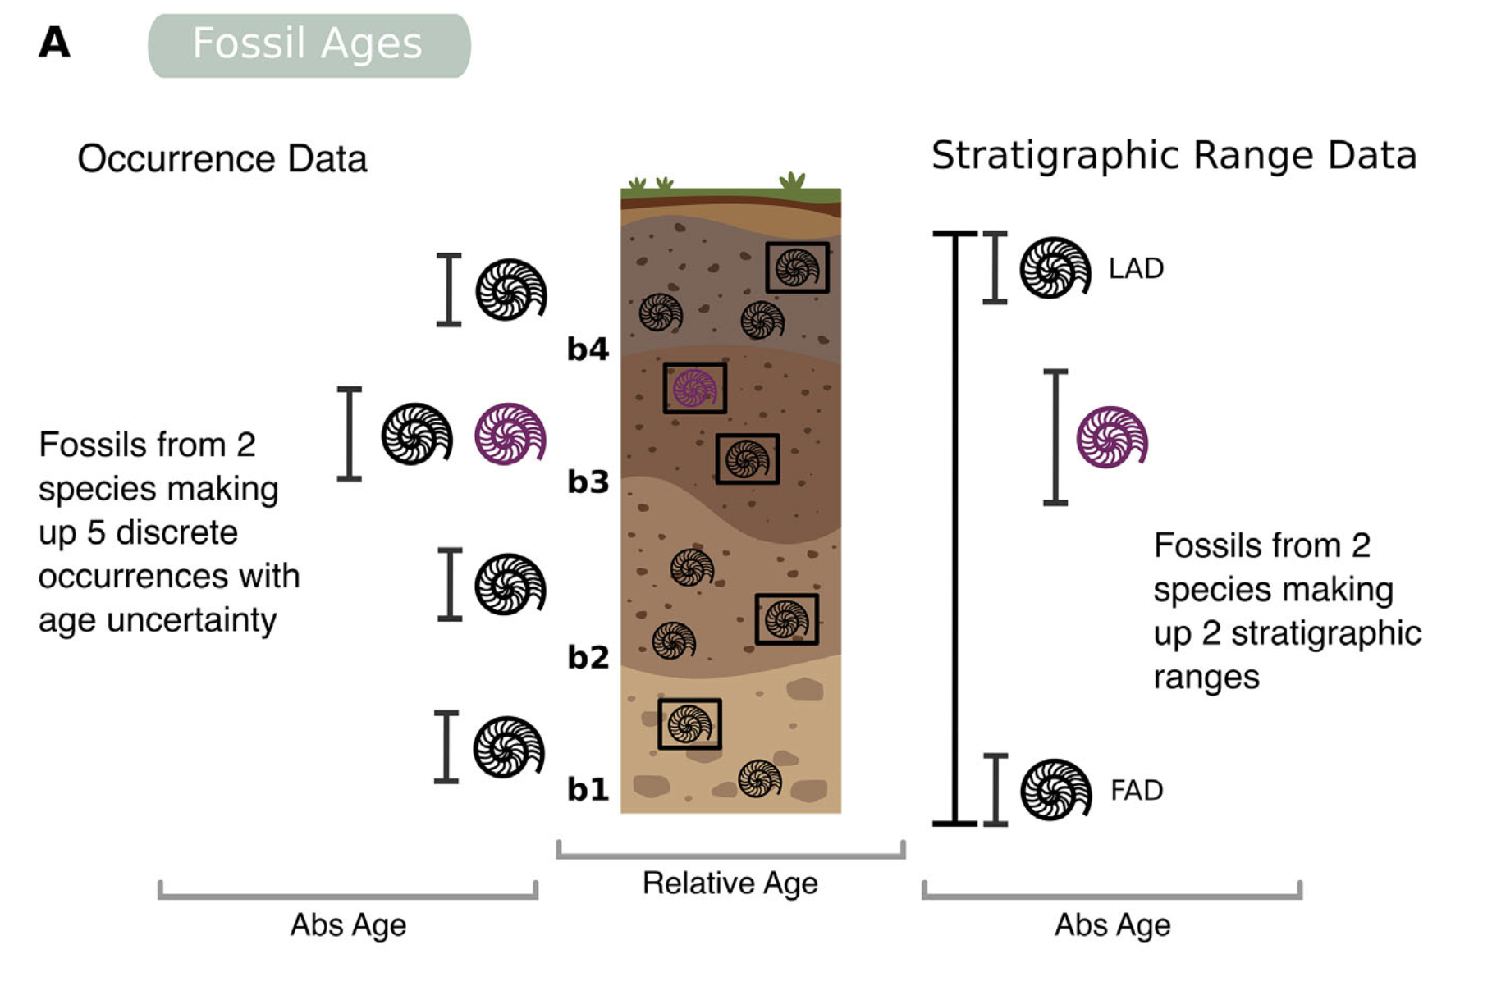
Mulvey, L. P. A., M. C. Nikolic,
B. J. Allen, T. A. Heath, and R. C. M. Warnock
(2025). From fossils to phylogenies: exploring
the integration of paleontological data into
Bayesian phylogenetic inference. Paleobiology
51, 214–236.
https://doi.org/10.1017/pab.2024.47
Class focus area: Bayesian inference
EEB603: Brian O’Meara
All quotes and images from the above paper unless otherwise noted

Slide 2
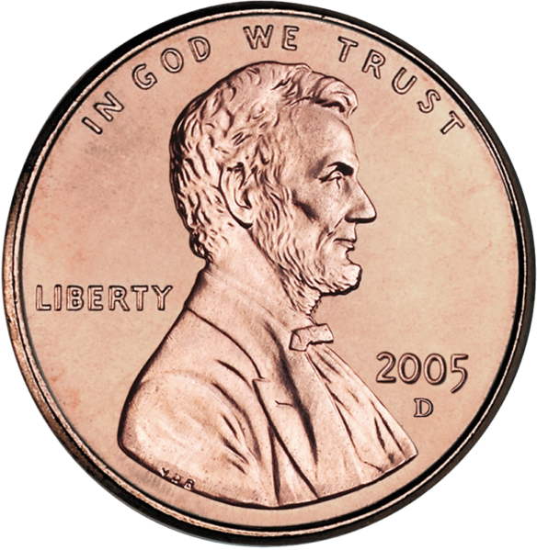

Flip a coin three times:
H
H
T
q = probability of landing heads
What is a good estimate of q for this coin?
2

Slide 3
Likelihood approach:
H
H
T
q = probability of landing heads
First choose a model
In this case, we think that the coin has an innate probability of landing heads, regardless of whether the previous toss landed heads, whether it’s sunny outside, or whether it was tossed with the right or left hand.
The simple model we will use is the binomial distribution.
3

Slide 4
Likelihood approach:
H
H
T
q = probability of landing heads
First choose a model (binomial distribution)
We now have our model and our data (2 heads out of 3 tosses).
Definition:
Likelihood of the hypothesis given the data
is proportional to the
Probability of the data given the hypothesis
4

Slide 5
Likelihood approach:
H
H
T
q = probability of landing heads
Likelihood of the hypothesis given the data
is proportional to the
Probability of the data given the hypothesis
In our case, the hypothesis is just a given value for q, and the data are getting 2 heads out of 3 tosses.
5

Slide 6
Likelihood of the hypothesis given the data
is proportional to the
Probability of the data given the hypothesis
In our case, the hypothesis is just a given value for q, and the data are getting 2 heads out of 3 tosses.
For example, if we set q to 0.4, the probability of seeing 2 heads out of 3 tosses is:
P(2 H, 1 T | q=0.4) = = 0.288
6

Slide 7
Likelihood of the hypothesis given the data
is proportional to the
Probability of the data given the hypothesis
In our case, the hypothesis is just a given value for q, and the data are getting 2 heads out of 3 tosses.
For example, if we set q to 0.4, the probability of seeing 2 heads out of 3 tosses is:
P(2 H, 1 T | q=0.4) = = 0.288
We can then say the likelihood of the hypothesis q=0.4 given the data of 2 heads out of 3 tosses is 0.288.
7

Slide 8
Likelihood of the hypothesis given the data
is proportional to the
Probability of the data given the hypothesis
In our case, the hypothesis is just a given value for q, and the data are getting 2 heads out of 3 tosses.
For example, if we set q to 0.4, the probability of seeing 2 heads out of 3 tosses is:
P(2 H, 1 T | q=0.4) = = 0.288
We can then say the likelihood of the hypothesis q=0.4 given the data of 2 heads out of 3 tosses is 0.288.
Likelihood takes as the best estimate of q that value of q which maximizes the probability of the observed data.
8

Slide 9
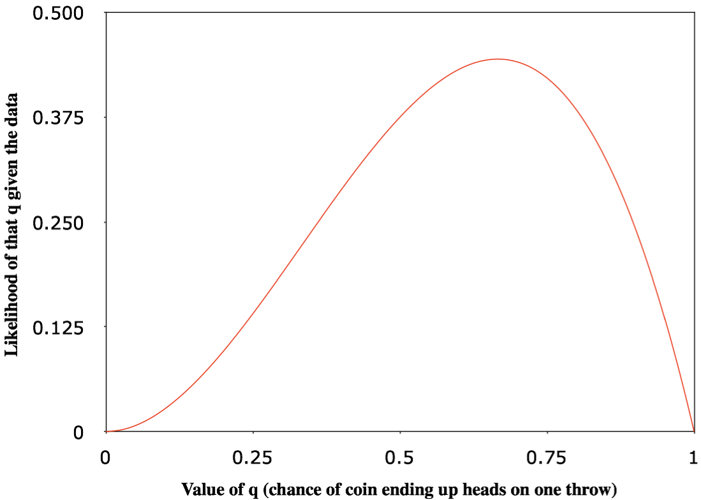
In our case, the hypothesis is just a given value for q, and the data is getting 2 heads out of 3 tosses.
0.667
9

Slide 10

Likelihood
10

Slide 11
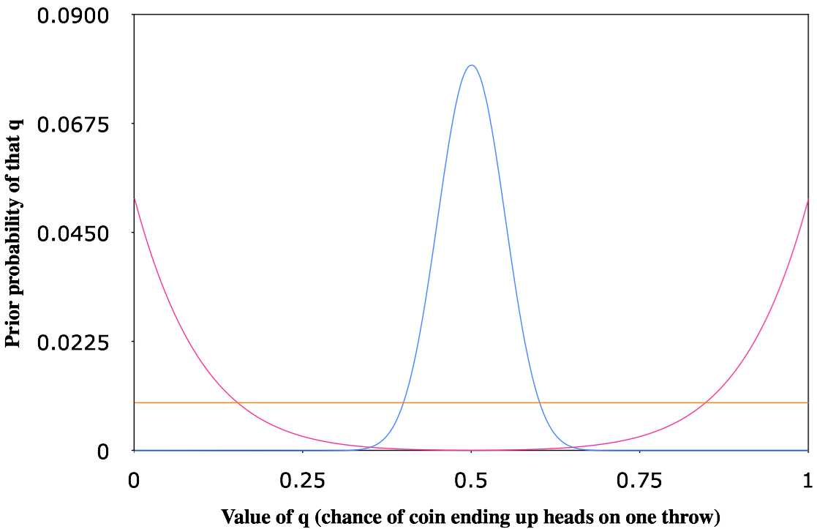
Prior probability
11

Slide 12
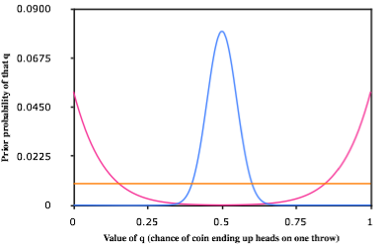
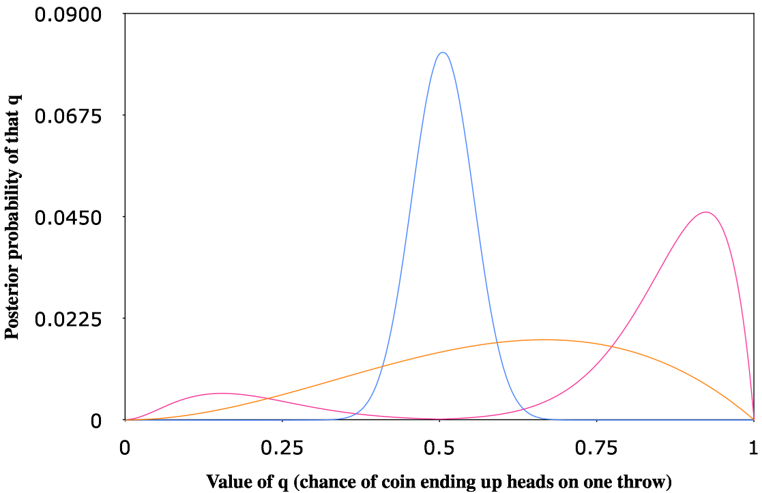
Posterior probability
12

Slide 13
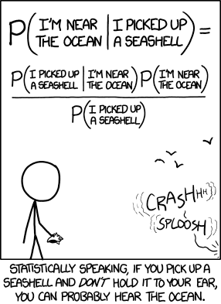
https://xkcd.com/1236/
Notes:
Conditional probability

Slide 14
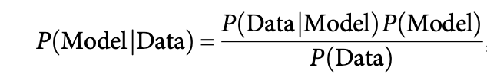

Slide 15
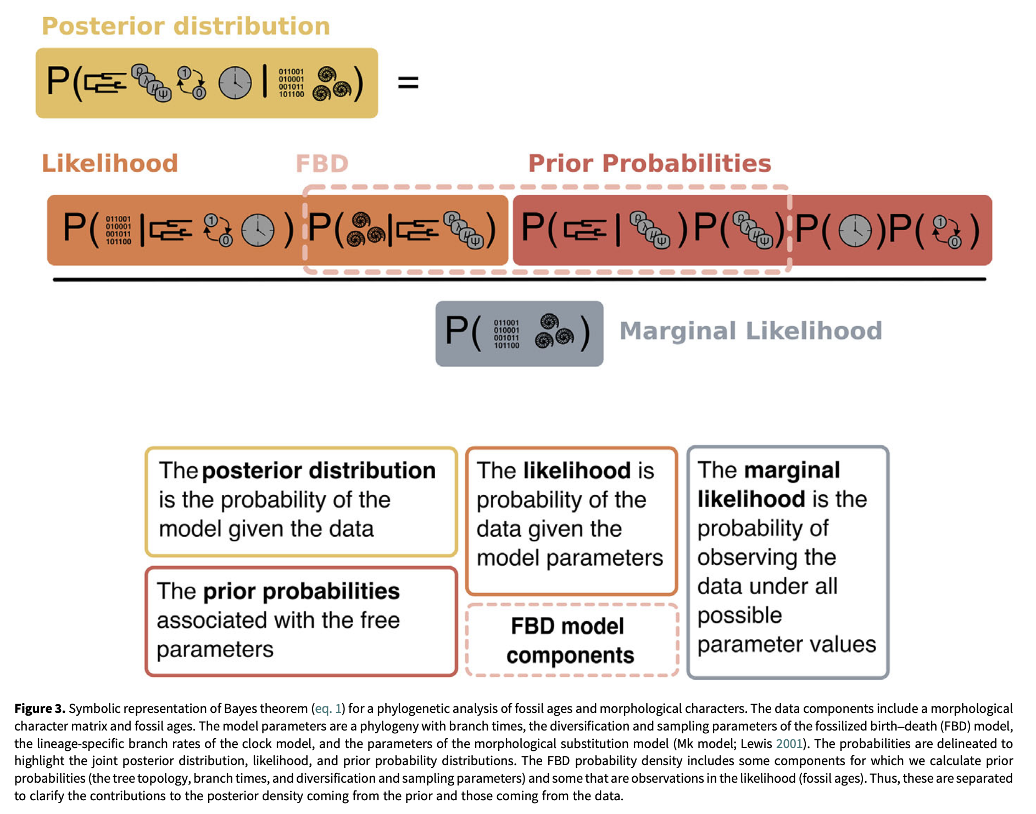

Slide 16
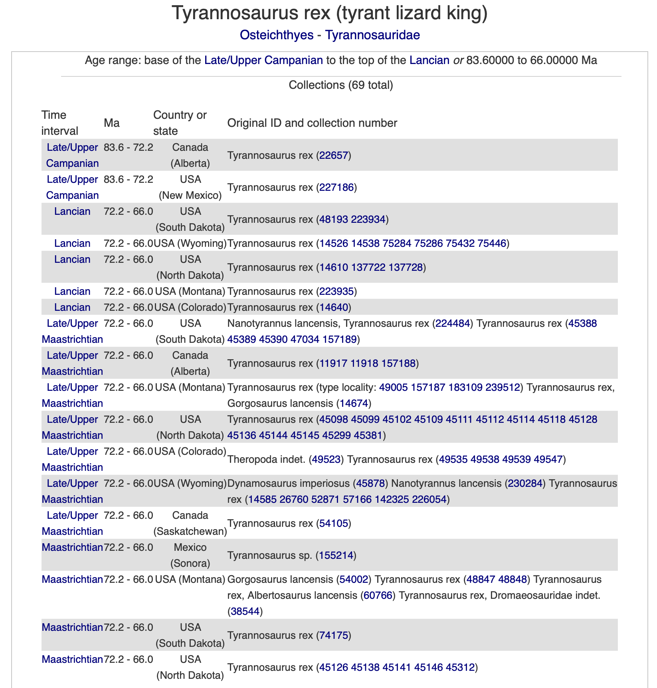
paleobiodb.org

Slide 17
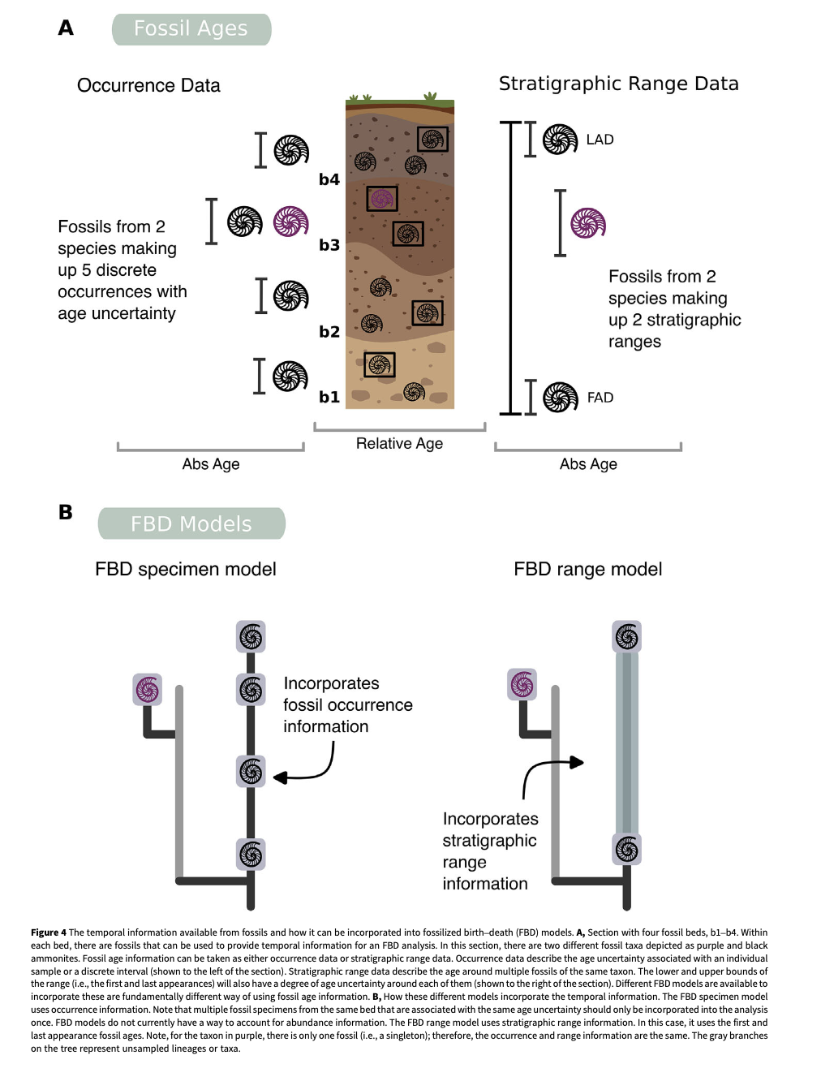

Slide 18
